Slide 1
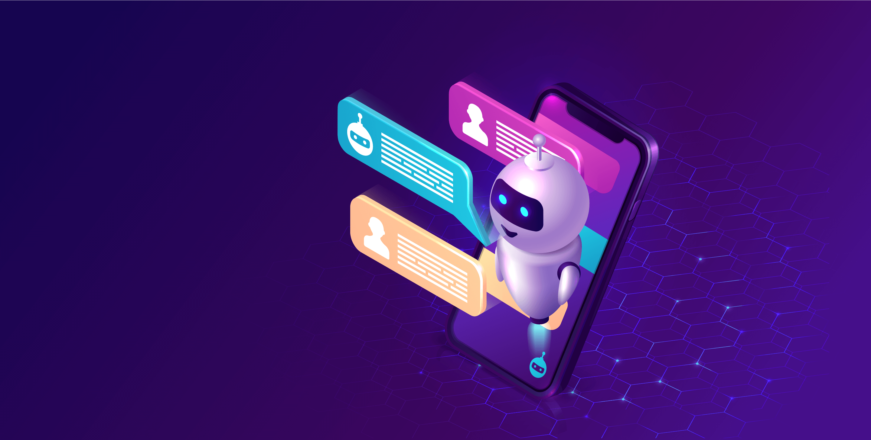
Multimodel AI ChatBot for YouTube Video QA
Harnessing the Power of AI to Unlock Video Insights
By: Nour Kashto

Slide 2
INTRODUCTION:
The goal of this final project is to develop a RAG system or AI bot that combines the power of text and audio processing to answer questions about YouTube videos. The bot will utilize natural language processing (NLP) techniques and speech recognition to analyze both textual and audio input, extract relevant information from YouTube videos, and provide accurate answers to user queries.

Slide 3
Data Source:
https://www.youtube.com/watch?v=GFLb5h2O2Ww&list=PLFs4vir_WsTyS2cy4vj4obl5igqCOV749&t=30s
Data source from kurzgesagt youtube channel (immune system).
Contain 20 contain educational videos about different health subjects.

Slide 4
Data Exploring:
Data Cleaning: Clean the data from special characters and replacing non-alphanumeric characters with spaces.
Metadata Extraction: Extract video\playlist id’s from Youtube.
Download Data: download the data and prepare as mp3 files.
Transcript Data: using Whisper-large-v3 model, to get the data transcripted, and tokenized.

Slide 5
Pinecone:
Initialize Pinecone: sets up a Pinecone index for storing and retrieving vector data, using specified parameters like API key and dimension.
Embeddings: processes transcripts by splitting them into manageable chunks, generates embeddings for each chunk using the OpenAI model.
Upsert Embeddings: function inserts or updates text chunks and their corresponding embeddings into a Pinecone index, ensuring that each embedding is associated with its respective text.
Langchain: creates a Pinecone vector store object to enable the storage and retrieval of text embeddings.

Slide 6
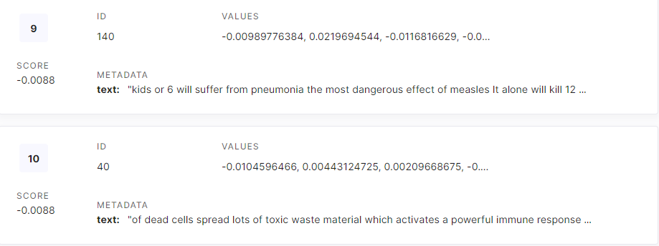
Establishes a Pinecone index and OpenAI embeddings model, processes transcripts into chunks with corresponding embeddings, and stores them in the index for efficient retrieval.

Slide 7
Intelligent QA Agent:
Transcript Reading: reads transcripts from JSON files stored in a specified directory, ensuring proper file path construction for accurate access.
Language Model Initialization: An OpenAI language model is initialized with a defined temperature to control response variability, setting the foundation for generating intelligent responses.
RetrievalQA Setup: A RetrievalQA instance is created, integrating the language model with a vector store retriever and memory to enhance the quality of information retrieval from transcripts.
Agent Initialization: The agent is initialized with tools for searching and returning relevant excerpts from video transcripts, enabling efficient interaction and response generation.

Slide 8
Evaluating QA Agent Responses:
Assessing Output Quality: evaluate the responses generated by the QA agent, ensuring they meet high standards of quality.
Labeled Criteria Evaluation: utilize labeled criteria, such as correctness, conciseness, and coherence, to systematically analyze the agent's output and identify areas for improvement.
Continuous Improvement: Through these evaluations, we aim to enhance the QA agent's performance, ensuring it delivers accurate and relevant information to users effectively.

Slide 9
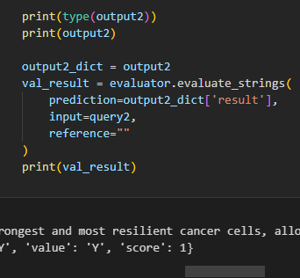
Evaluating Results:
In our evaluation of the QA agent's performance, we found that 4 out of 5 queries received a score of 1 for coherence. This high coherence score indicates that the majority of the responses were well-structured and logically organized, effectively conveying relevant information to users. Such consistency in coherence suggests that the agent is adept at maintaining context and providing clear answers, which is crucial for user satisfaction

Slide 10
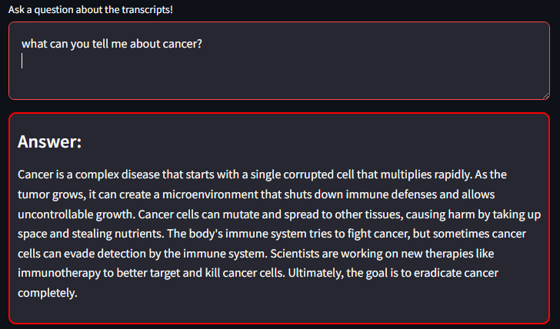
Model Test:

Slide 11
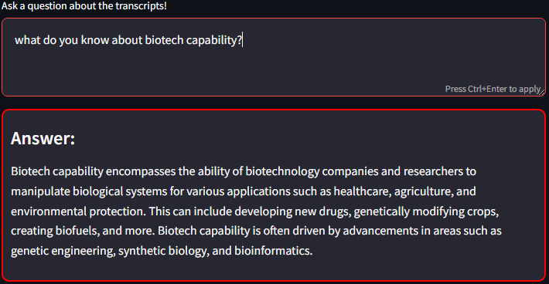

Slide 12
Thank you all for your time and attention!
Any Questions??

